Slide 1

Datta Meghe College of Engineering Airoli, Navi Mumbai Department of Information Technology
University of Mumbai
Academic Session : 2025-26
A Presentation
On
“LevelUp – AI Career Guidance”
Presented By
Devendra Prakash Pathare B.E., Semester 7, Div B, Roll No.- 23
Aditya Sanjay Shelar B.E., Semester 7, Div B, Roll No.- 47
Amey Rajendra Surwase B.E., Semester 7, Div B, Roll No.- 17
Mohin Salim Tadvi B.E., Semester 7, Div B, Roll No.- 21
Under the Guidance of
Prof. S. U. Kumane

Slide 2
Content
Introduction
Problem Definition
Aims and Objectives
Literature Review
Proposed Methodology
Time Frame
References

Slide 3
Introduction
Career decision-making plays a vital role in shaping a student’s future, yet conventional guidance approaches often lack personalization, adaptability, and ongoing support.
With the rapid evolution of technology and job market dynamics, there is an increasing need for intelligent systems that can assist students in identifying suitable career paths aligned with their skills, interests, and aspirations.
This project introduces an AI-powered career guidance platform that leverages large language models to provide personalized recommendations, progress tracking, and a gamified environment to foster continuous engagement and informed decision-making.

Slide 4
Problem Definition
Generic Career Guidance: Traditional career counseling methods often provide broad, non-specific advice that fails to align with a student’s unique strengths, interests, and goals.
Lack of Intelligent Personalization: Most existing systems do not leverage AI or language models, limiting their ability to offer adaptive, data-driven, or contextual career recommendations.
Low Engagement and Support: Current platforms lack interactive features, personalized feedback, or peer-professional interaction, making it difficult for students to stay motivated and career-focused.

Slide 5
Literature Review
Most older systems give the same career advice to everyone, without understanding each student’s interests or skills.
Recent studies show that using AI like ChatGPT can give better and more personalized career suggestions.
Many existing systems don’t have features like levels, XP, chats with professionals, or proper testing with large groups.

Slide 6
Sr.No: | Paper Title | Authors | Finding | Gap
1. | AI‑based Personalized Recommendation System for Students using LLMs 2023 | S. Raj, V. G. Renumol | Uses GPT-3/4 to give career suggestions based on skills, interests, and academics. Understands free-text input like “I like coding and design.” Suggests roles, missing skills, and learning resources better than traditional methods. | GPT-based career systems are still new and not widely adopted. May produce biased or inaccurate (hallucinated) responses. Lacks large-scale testing and depends heavily on well-crafted prompts.
2. | CareerX : AI-Powered Career Path Recommender Systtem for College Students April 2025 | Yuvraj Gupta | Integrates NLP and machine learning to analyze student resumes, interests, and job market trends—all via a mobile app. Offers personalized modules including career path suggestions, resume analysis, learning roadmaps, and job matching. Reports strong early results: ~90% student satisfaction, improved resume quality, and better job matching accuracy. | No XP or level system to keep students motivated that is no gamification. The system was tested on only a few users — no proof it works at scale. Doesn’t use smart prompts or GPT models — likely based on basic rule-based methods.

Slide 7
Sr.No: | Paper Title | Authors | Finding | Gap
3. | Trends and Characteristics of Career Recommendation Systems for Fresh Graduated Students Year: 2022 | Puji Catur Siswipraptini, Arief Ramadhan, Widodo Budiharto | Reviews various career recommendation systems for fresh graduates. Identifies rule-based, content-based, and hybrid system architectures. Stresses use of academic data, interests, and market trends. Notes that most systems are web/mobile-based for easy access. | Most systems follow fixed rules and can’t adjust to different students. They don’t use smart AI models (like GPT) or allow typing answers in normal language. There are no fun features (like levels or points) to keep students interested. These systems haven’t been tested with many users, so we don’t know if they work well in real life. .

Slide 8
Aims And Objectives
Aim:
To design an AI-driven career guidance platform that provides personalized career recommendations, tracks skill development, and promotes student-professional engagement through interactive tools.
Objectives:
To analyze student profiles using large language models (LLMs)
To recommend suitable career paths based on interests, skills, and academics
To identify skill gaps and suggest relevant learning resources
To implement a gamified XP-level system to boost student motivation
To facilitate communication between students and professionals via community chat
To provide resume building and AI-based resume feedback features

Slide 9
Proposed Methodology
Start
Login/Signup
Student
Working professional
Retest
Test / AI
Dashboard
Career
CHAT AI
Student Profile
XP Level Students
Dashboard
Filtering /
Suggestion
XP/LEVEL
Community
Profile
Task
Resume
Upload
Chat
AI context for new

Slide 10
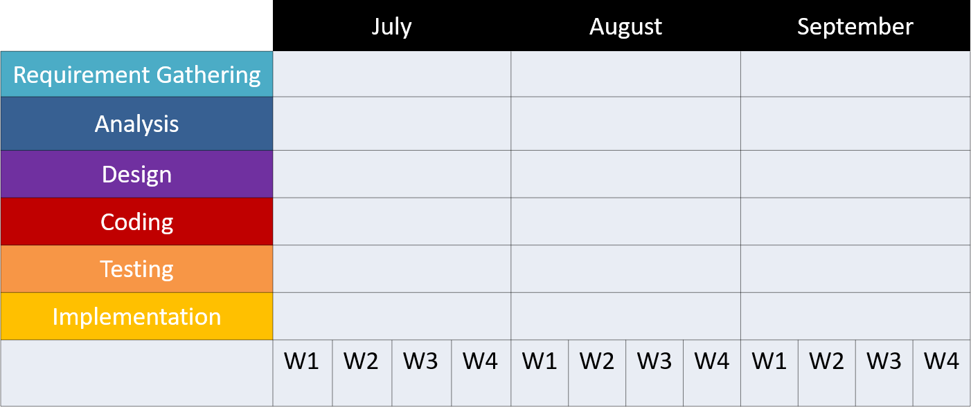
Time Frame (Planning) of completion of project

Slide 11
References
Raj, S., & Renumol, V. G. (2023). AI-Based Personalized Recommendation System for Students Using LLMs. https://www.researchgate.net/publication/379925829_AI_based_Personalized_Recommendation_System_for_Students_using_LLMs
Gupta, Y. (2025). CareerX: AI-Powered Career Path Recommender System for College Students. https://www.researchgate.net/publication/379935023_Envisioning_Tomorrow_AI_Powered_Career_Counseling
Siswipraptini, P. C., Warnars, H. L. H. S., Ramadhan, A., & Budiharto, W. (2022). Trends and Characteristics of Career Recommendation Systems for Fresh Graduated Students. https://ieeexplore.ieee.org/document/9779037

Slide 12
THANK YOU

